Slide 1


The basics of the new UNITY INPUT SYSTEM
A small step-by step guide
Made by Niek Middel

Slide 2
introduction
Install (slide 3 to slide 4)
Setup (slide 5 to slide 8)
Intigration (slide 9 to slide y)

Slide 3
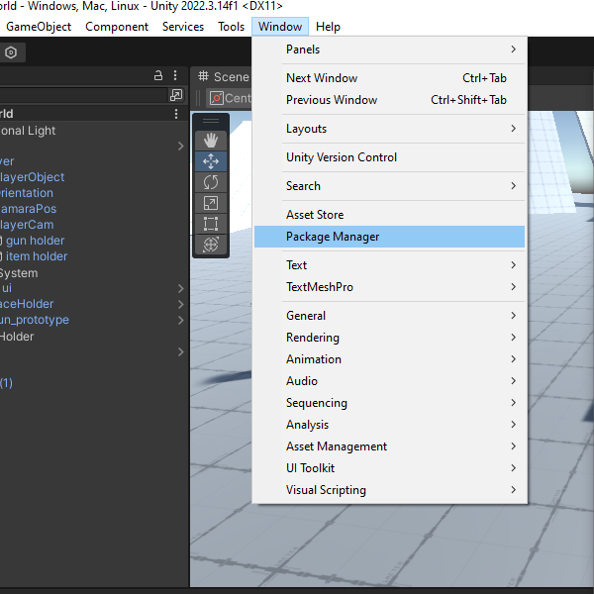
Install-Step 1 open package manager
Open the windows dropdown and select the package manager

Slide 4
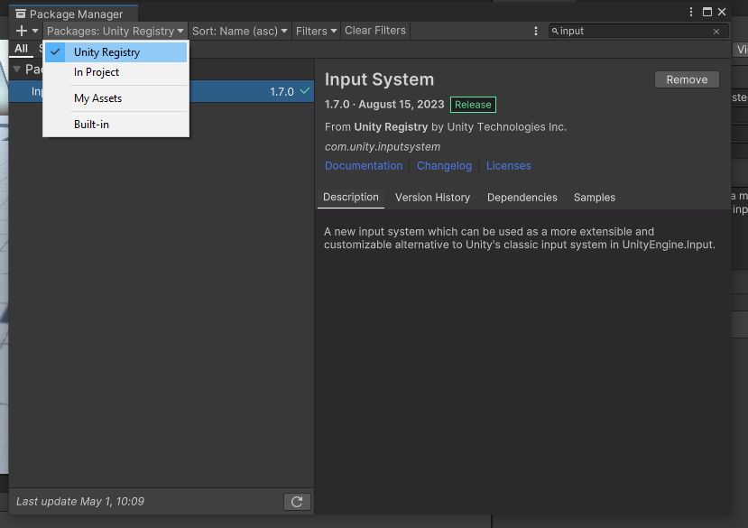
Install-Step 2 install input system
Once the package manager is open make sure you click 'packages'
Select 'unity registry'
Scroll down on search 'input system' and press install

Slide 5
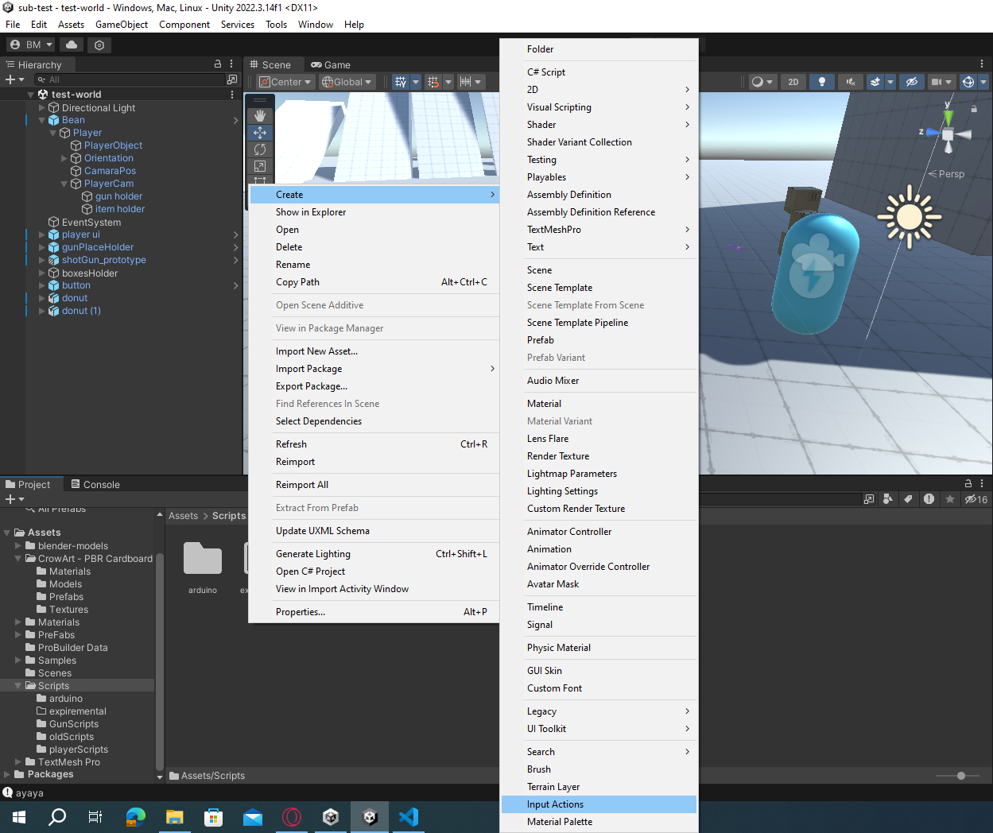

Setup step 1 make the input action
Right click in the project window in your asset folder
Select 'create'
Select 'input action'
Name your input action whatever you think is right
If you did everything right, you should have a component looking like this:

Slide 6
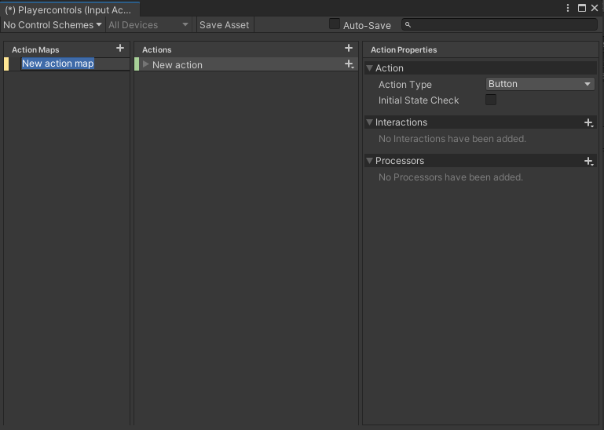
Setup step 2 creating an actionmap
Double click the 'input action' component. That opens this window
2 . Click the plus icon next to the 'action map' to make an action map or use the one given by default
An action map is the place where you keep your bundle of keybinds. This allows you to have saperate controles for seperate situation without it being too cluttered

Slide 7
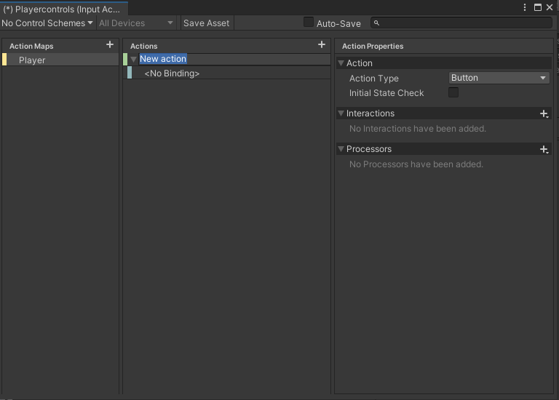
Setup 3 creating an actions
Click the plus icon next to 'Action' to make a new action and name it what you want it to do
The action window determens the type of binding and value you want from it.
Interactions allows you to specify what kind of input you want to trigger the action
Remeber to press the 'Save asset' at the top middle of the window or check the auto-save box

Slide 8
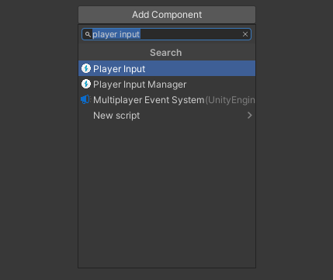
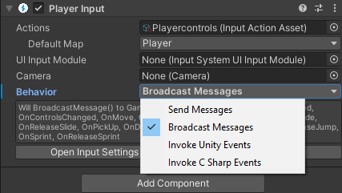
Setup Step 4 adding the player input component
Select the object you want to control. Select the 'add component' and add the 'player input'
Drag your input action asset in here
Drag your action map in here
Send message: allows every script on this object to use the event related to the input action asset
Broadcast message: is the same as 'send message' but instead of just working on the object, it works on all children of that obejct.
Invoke unity events: makes you specify the events on the component.
Invoke c sharp events: makes you specify the events inside a script.
Pick 'broadcast message for the sake of simplicity'
To call an action with the 'messages' behavior, you have use a function in the code called On[name of action]

